Slide 1
Title: System Design for Public Transport Fare Collection and Management System
Metro Trans Investments Ltd
Prepared by: JoyAnn Wairimu Mwangi
Supervisor: Charles Malungu

Slide 2
System Architecture & Scalability
Client-Server Architecture with Cloud-Based Integration
Frontend: HTML/CSS and JS
Backend: Python (Flask)
Database: MySQL
Scalability Features:
Horizontal Scaling (Adding More Servers)
Database Sharding for Large Datasets
Load Balancing for High Traffic
Cloud Hosting for Reliability

Slide 3
Database & Data Handling
Key Tables & Relationships:
Users Table: Passenger, Tout, Admin Information
Transactions Table: Logs All Payments
Bus Fare Records: Tracks Fare Collections
Fraud Detection: Flags Suspicious Transactions
Data Handling:
Encryption for secure storage
Data validation for accuracy
Logging & Auditing for transparency
Archiving Policies for database performance

Slide 4
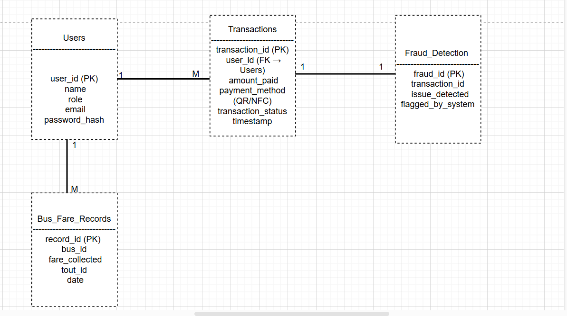

Slide 5
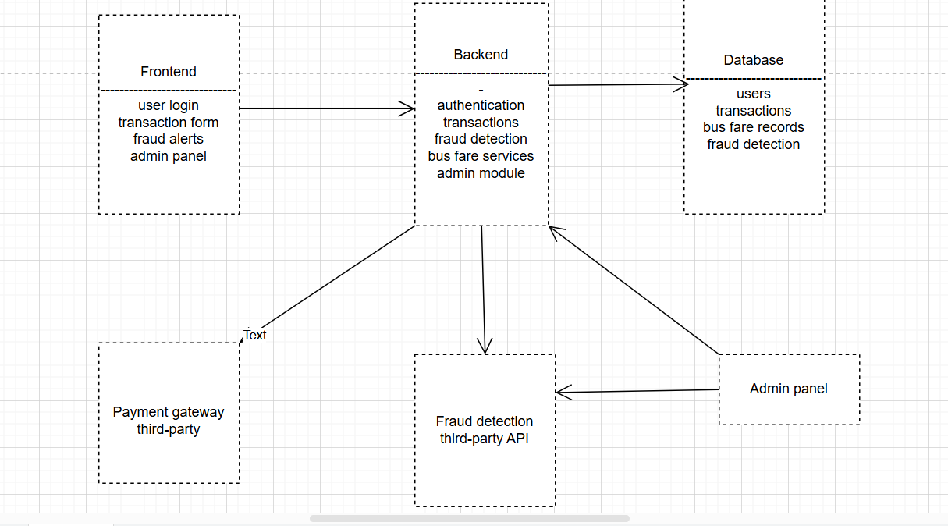

Slide 6
Security & Performance
Security Measures:
Authentication for Role-Based Access
Fraud Detection AI for Anomaly Detection
Transaction Encryption
Performance Optimization:
Asynchronous Processing for Faster Transactions
Database Indexing for Quick Access
API Rate Limiting to Prevent Overload

Slide 7
System Functionality & Interfaces
Core Features:
Passengers: Pay fares via NFC, QR Codes
Touts: Verify & Track Payments
Admins: Monitor Transactions, Detect Fraud, Generate Reports
API & Interfaces:
QR/NFC API for Digital Ticket Validation
Admin API for Reporting & Fraud Detection

Slide 8
System Design Considerations & Goals
System Considerations:
Redundancy & Failover for Reliability
Fault Tolerance & Auto Recovery
Load Balancing for Efficient Resource Distribution
Design Goals:
Efficiency: Transactions under 2 seconds
Security: Prevents fraud & unauthorized access
Scalability: Supports thousands of users
Reliability: 99.9% uptime with automated backups

